Slide 1
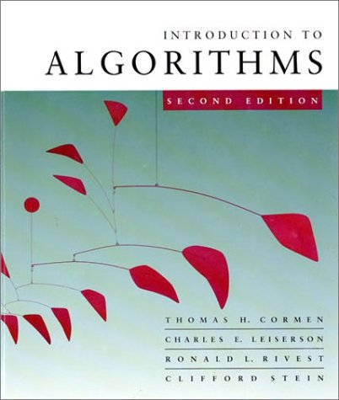
Lecture 1
Algorithms
Dr. M Firoz Mridha
Associate Professor
Department of CSE
Bangladesh University of Business and Technology(BUBT)

Slide 2
Introduction
The methods of algorithm design form one of the core practical technologies of computer science.
The main aim of this lecture is to familiarize the student with the framework we shall use through the course about the design and analysis of algorithms.
We start with a discussion of the algorithms needed to solve computational problems. The problem of sorting is used as a running example.
We introduce a pseudocode to show how we shall specify the algorithms.

Slide 3
Algorithms
The word algorithm comes from the name of a Persian mathematician Abu Ja’far Mohammed ibn-i Musa al Khowarizmi.
In computer science, this word refers to a special method useable by a computer for solution of a problem. The statement of the problem specifies in general terms the desired input/output relationship.
For example, sorting a given sequence of numbers into nondecreasing order provides fertile ground for introducing many standard design techniques and analysis tools.

Slide 4
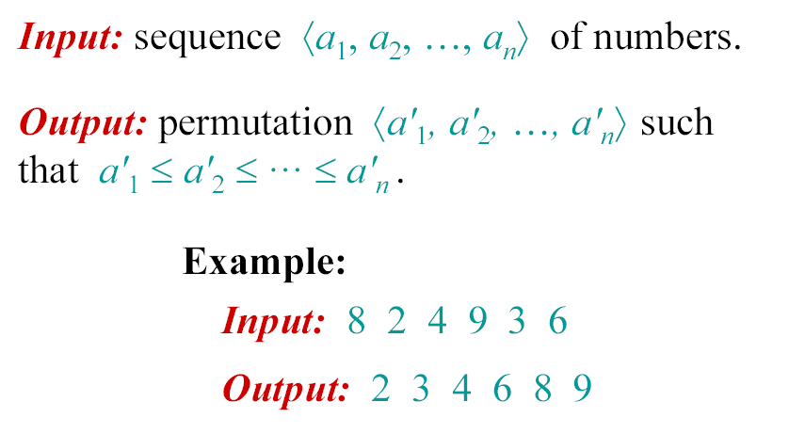
The problem of sorting

Slide 5
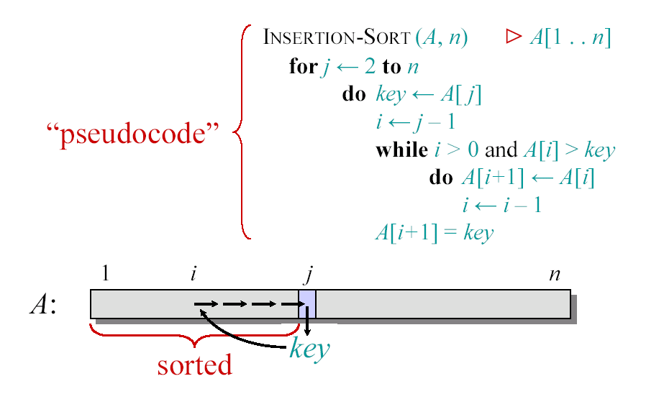
Insertion Sort

Slide 6

Example of Insertion Sort

Slide 7
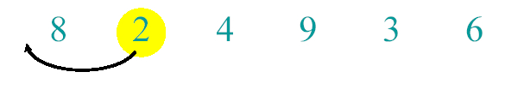
Example of Insertion Sort

Slide 8
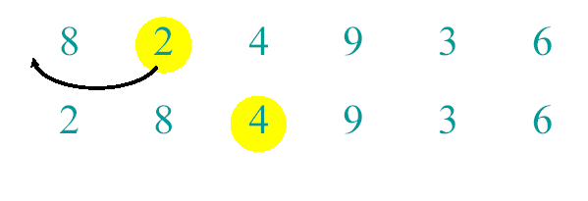
Example of Insertion Sort

Slide 9
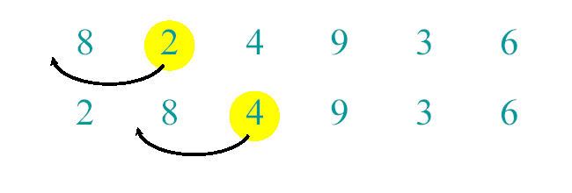
Example of Insertion Sort

Slide 10
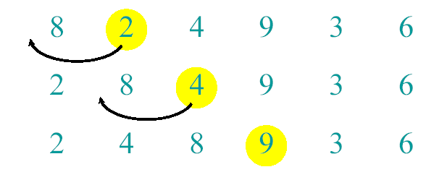
Example of Insertion Sort

Slide 11
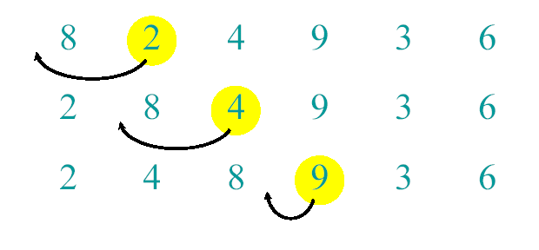
Example of Insertion Sort

Slide 12
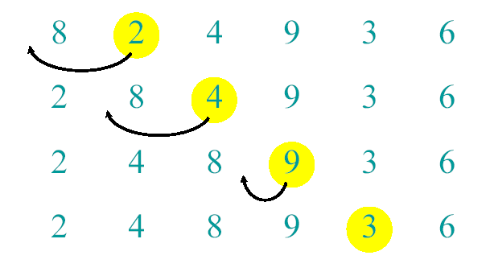
Example of Insertion Sort

Slide 13
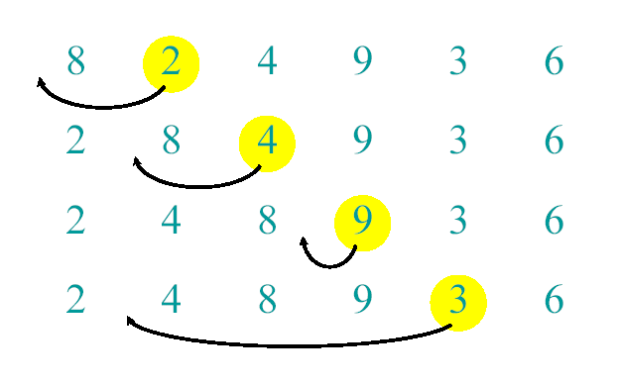
Example of Insertion Sort

Slide 14
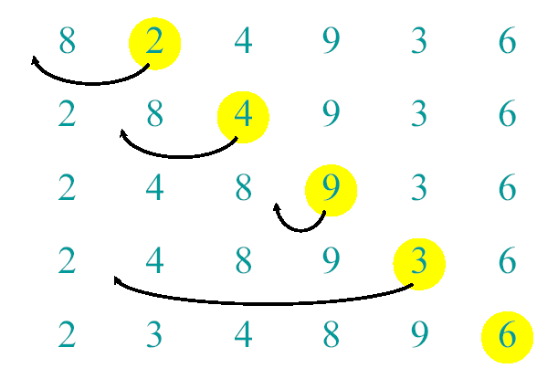
Example of Insertion Sort

Slide 15
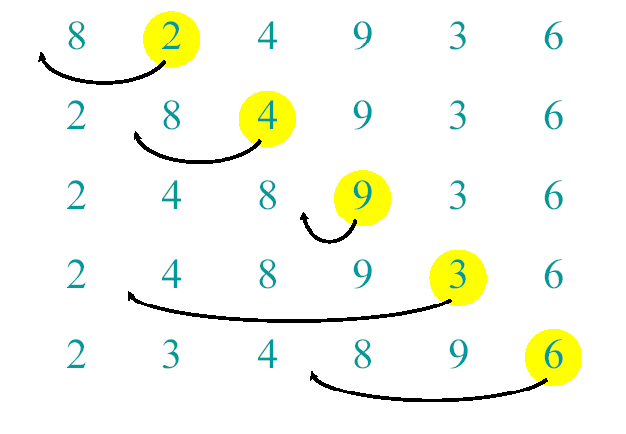
Example of Insertion Sort

Slide 16
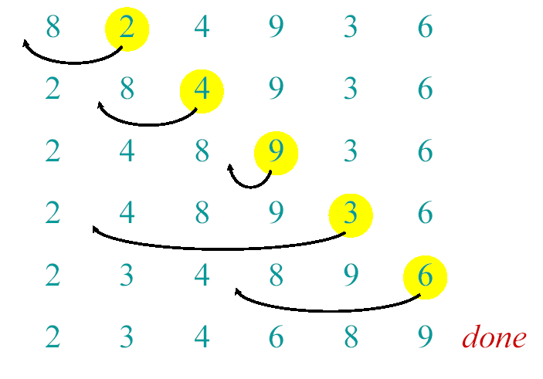
Example of Insertion Sort

Slide 17
Analysis of algorithms
The theoretical study of computer-program
performance and resource usage.
What’s more important than performance?
• modularity
• correctness
• maintainability
• functionality
• robustness
• user-friendliness
• programmer time
• simplicity
• extensibility
• reliability

Slide 18
Analysis of algorithms
Why study algorithms and
performance?
• Algorithms help us to understand scalability.
• Performance often draws the line between what
is feasible and what is impossible.
• Algorithmic mathematics provides a language
for talking about program behavior.
• The lessons of program performance generalize
to other computing resources.
• Speed is fun!

Slide 19
Running Time
• The running time depends on the input: an
already sorted sequence is easier to sort.
• Parameterize the running time by the size of
the input, since short sequences are easier to
sort than long ones.
• Generally, we seek upper bounds on the
running time, because everybody likes a
guarantee.

Slide 20
Kinds of analyses
Worst-case: (usually)
• T(n) = maximum time of algorithm
on any input of size n.
Average-case: (sometimes)
• T(n) = expected time of algorithm
over all inputs of size n.
• Need assumption of statistical
distribution of inputs.
Best-case:
• Cheat with a slow algorithm that
works fast on some input.

Slide 21
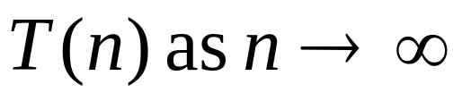
Machine-independent time
What is insertion sort’s worst-case time?
• It depends on the speed of our computer:
• relative speed (on the same machine),
• absolute speed (on different machines).
BIG IDEA:
• Ignore machine-dependent constants.
• Look at growth of
“Asymptotic Analysis”

Slide 22
Machine-independent time: An example
A pseudocode for insertion sort ( INSERTION SORT ).
INSERTION-SORT(A)
1 for j ← 2 to length [A]
2 do key ← A[ j]
3 ∇ Insert A[j] into the sortted sequence A[1,..., j-1].
4 i ← j – 1
5 while i > 0 and A[i] > key
6 do A[i+1] ← A[i]
7 i ← i – 1
8 A[i +1] ← key

Slide 23
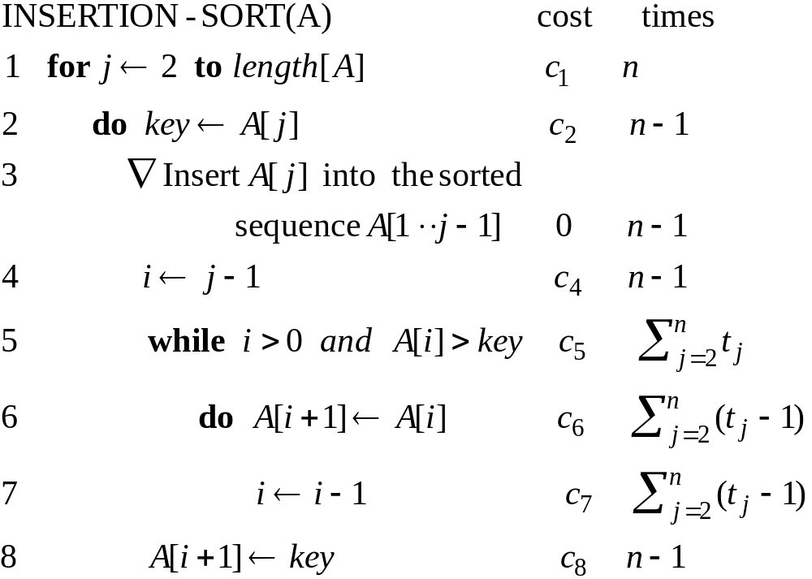
Analysis of INSERTION-SORT(contd.)

Slide 24
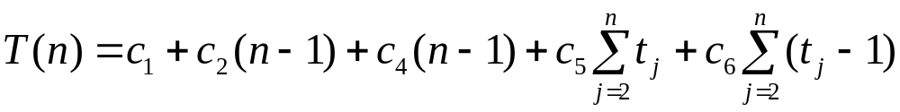
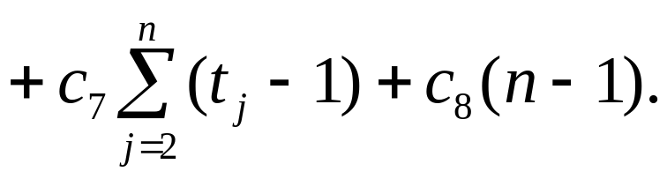
Analysis of INSERTION-SORT(contd.)
The total running time is

Slide 25
Analysis of INSERTION-SORT(contd.)
The best case: The array is already sorted.
(t_{j} =1 for j=2,3, ...,n)

Slide 26
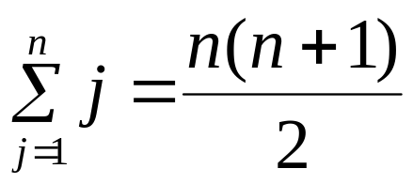
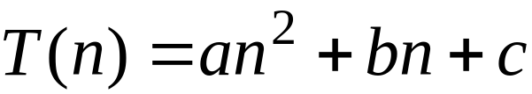
Analysis of INSERTION-SORT(contd.)
The worst case: The array is reverse sorted
(t_{j} =j for j=2,3, ...,n).

Slide 27
Growth of Functions
Although we can sometimes determine the exact running time of an algorithm, the extra precision is not usually worth the effort of computing it.
For large inputs, the multiplicative constants and lower order terms of an exact running time are dominated by the effects of the input size itself.

Slide 28
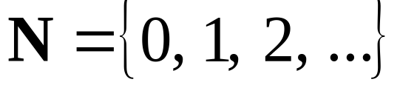
Asymptotic Notation
        The notation we use to describe the asymptotic running time of an algorithm are defined in terms of functions whose domains are the set of natural numbers

Slide 29



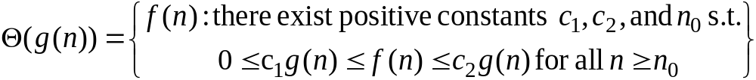






-notation
For a given function , we denote by the set of functions
A function belongs to the set if there exist positive constants and such that it can be “sandwiched” between and for sufficienly large n.

Slide 30

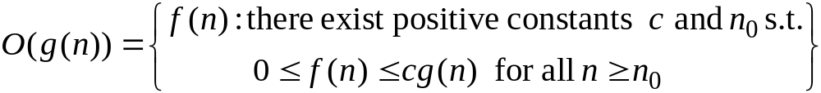
O-notation
For a given function , we denote by the set of functions
We use O-notation to give an asymptotic upper bound on a function, to within a constant factor.

Slide 31

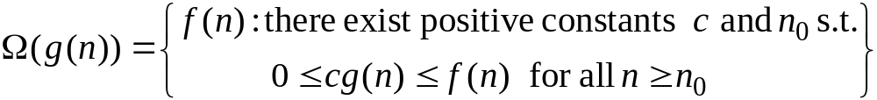
Ω-notation
For a given function , we denote by the set of functions
We use O-notation to give an asymptotic lower bound on a function, to within a constant factor.

Slide 32
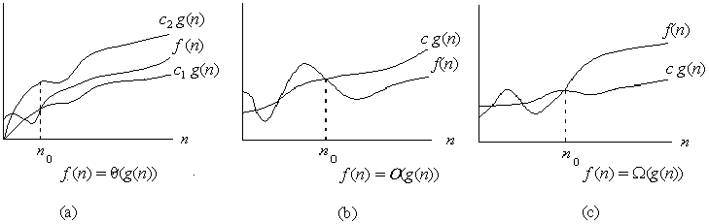

Asymptotic notation
Graphic examples of and .

Slide 33
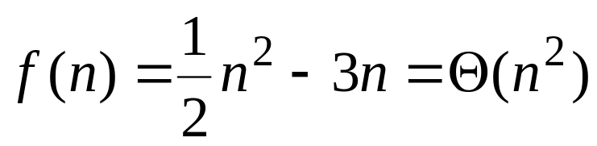
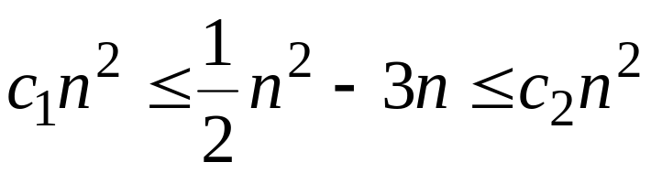
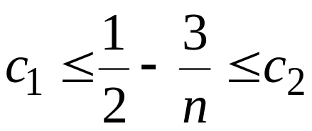
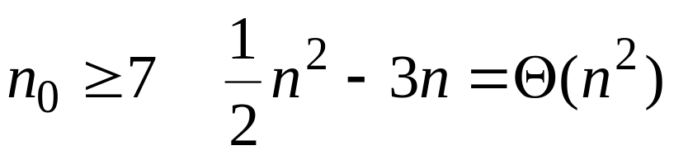
Example
Show that
We must find c₁ and c₂ such that
Dividing bothsides by n² yields
For

Slide 34

Theorem
For any two functions and , we have
if and only if

Slide 35
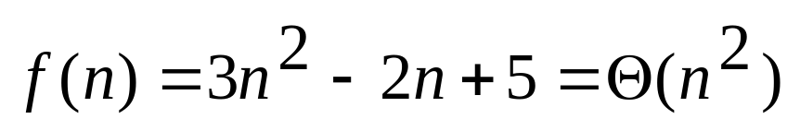
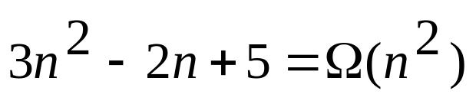
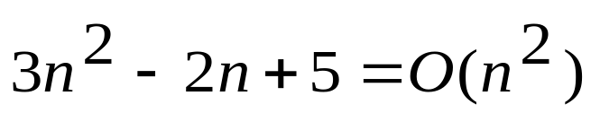
Example
Olması
olduğunu gösterir

Slide 36

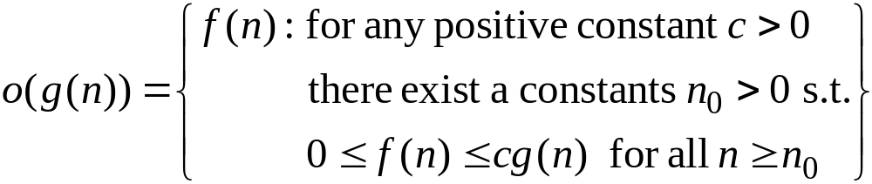
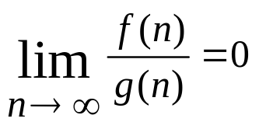
o-notation
We use o-notation to denote an upper bound that is not asymptotically tight.
We formally define as the set

Slide 37

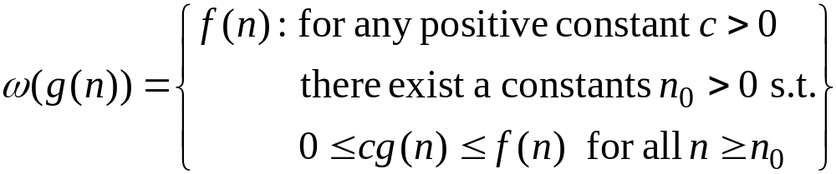
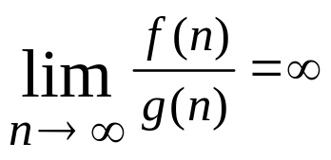
ω-notation
We use ω-notation to denote an upper bound that is not asymptotically tight.
We formally define as the set

Slide 38
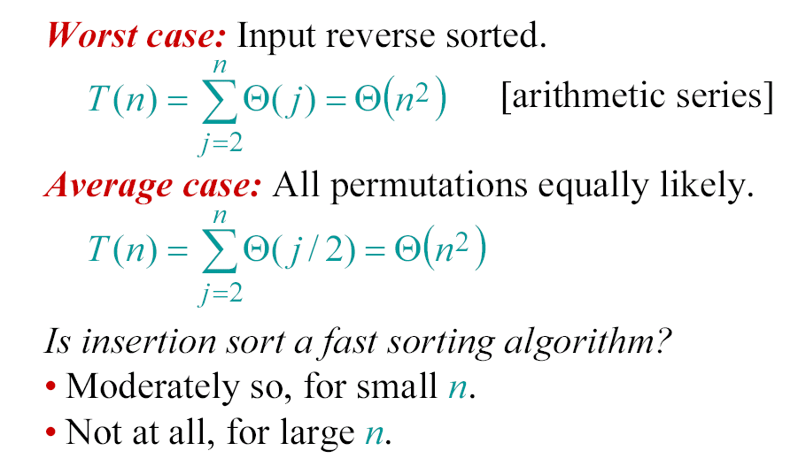
Insertion sort analysis

Slide 39
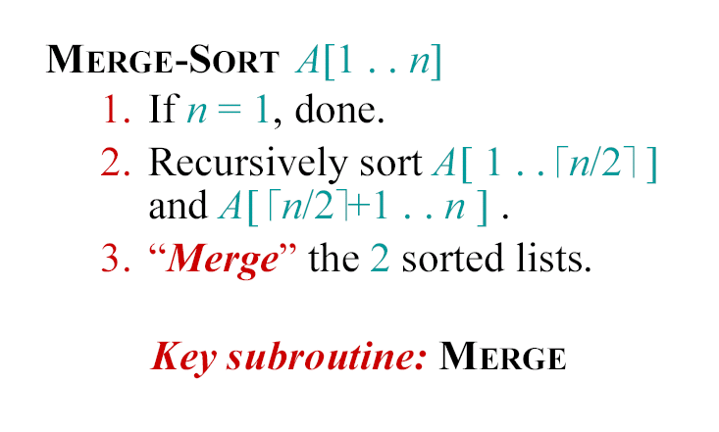
Merge Sort

Slide 40
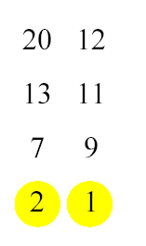
Merging two sorted arrays

Slide 41
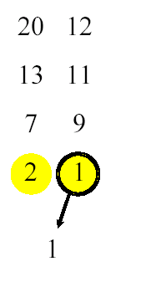
Merging two sorted arrays

Slide 42
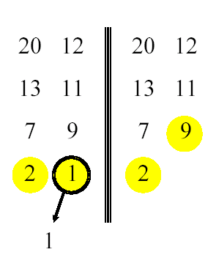
Merging two sorted arrays

Slide 43
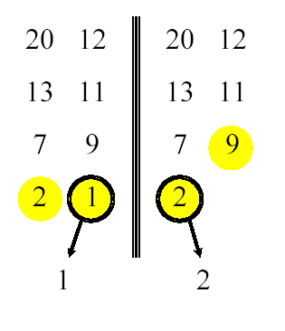
Merging two sorted arrays

Slide 44
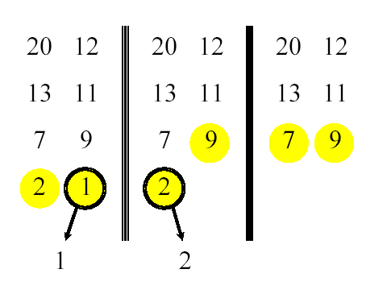
Merging two sorted arrays

Slide 45
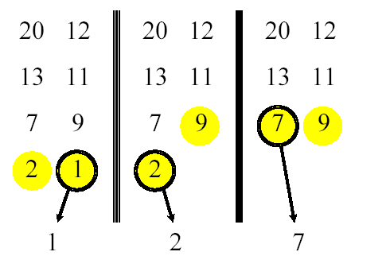
Merging two sorted arrays

Slide 46
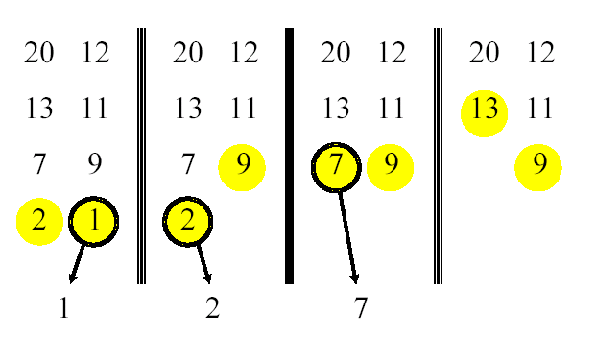
Merging two sorted arrays

Slide 47
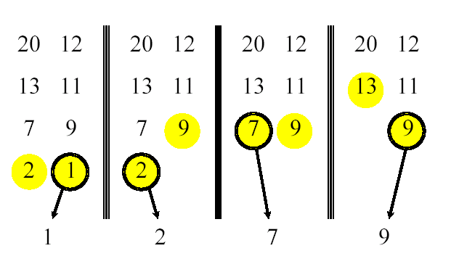
Merging two sorted arrays

Slide 48
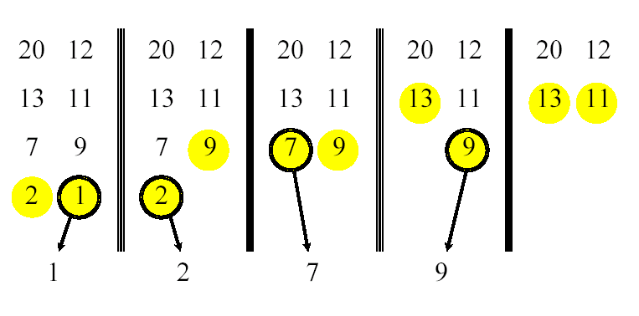
Merging two sorted arrays

Slide 49
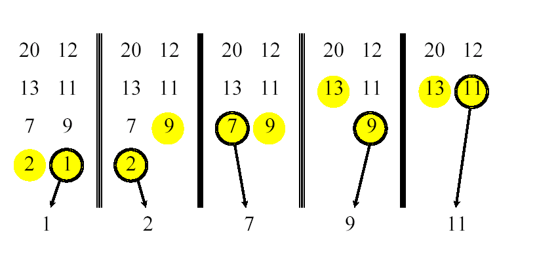
Merging two sorted arrays

Slide 50
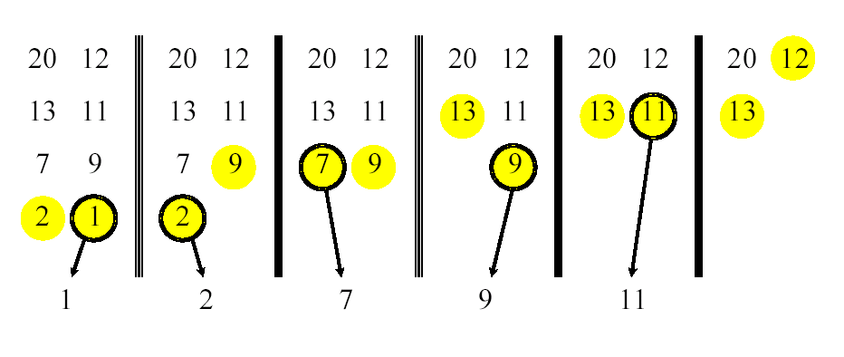
Merging two sorted arrays

Slide 51
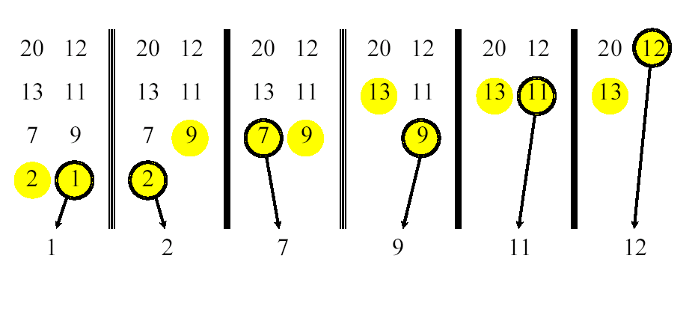
Merging two sorted arrays

Slide 52
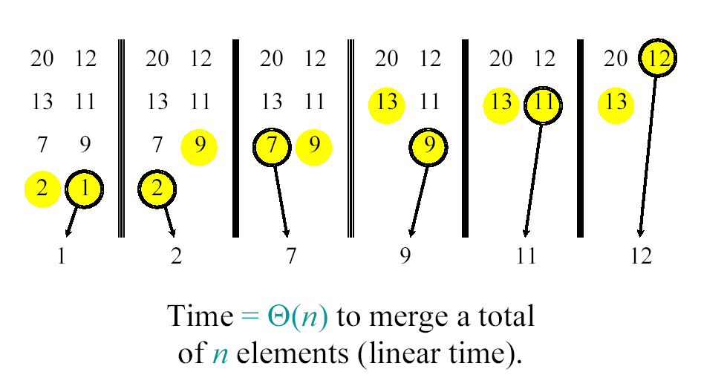
Merging two sorted arrays

Slide 53

Analyzing merge sort

Slide 54

Recurrence for merge sort

Slide 55

Recursion tree

Slide 56

Recursion tree

Slide 57

Recursion tree

Slide 58

Recursion tree

Slide 59

Recursion tree

Slide 60

Recursion tree

Slide 61

Recursion tree

Slide 62

Recursion tree

Slide 63

Recursion tree

Slide 64

Recursion tree

